Slide 1
Data Acquisition
3T MRI
2 chamber
4 chamber
Short-axis
4D tagging ^{[1]}
3D acquisition
Whole Heart SSFP
Cine SSFP
3DUS
Full volume
Apical view
14 phases
[1] Rutz AK, Ryf S, Plein S, Boesiger P, Kozerke S. Accelerated whole-heart 3D CSPAMM for myocardial motion quantification. MRM 2008.

Slide 2
Volunteers
Phantom
Dynamic cardiac phantom ^{[2]}
MR / US compatible
15 volunteers
MR / US within 7 days
Datasets
[2] Manzke R, Lutz A, Schenderlein M, Bornstedt A, Chan RC, Dietmeyer K, Rasche V. A New PVA-Based Dynamic Cardiac Phantom for Evaluation of Functional MR Imaging Methods at 3T. ISMRM proceedings 2010.

Slide 3
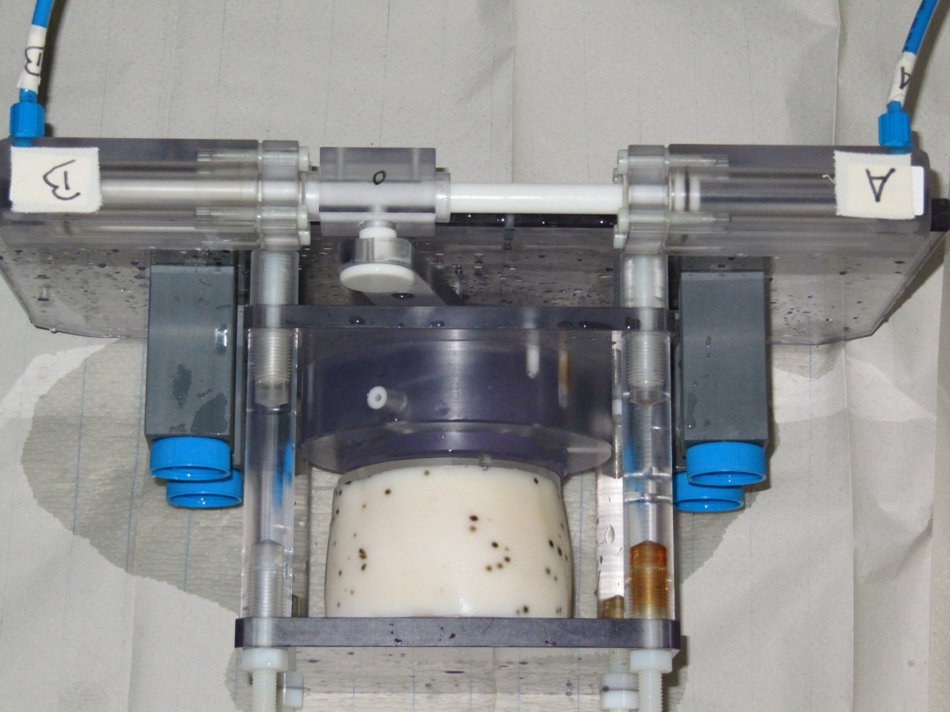
The Phantom

Slide 4
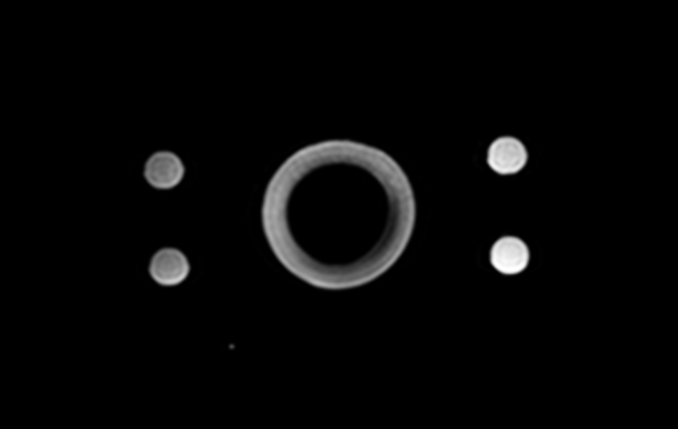


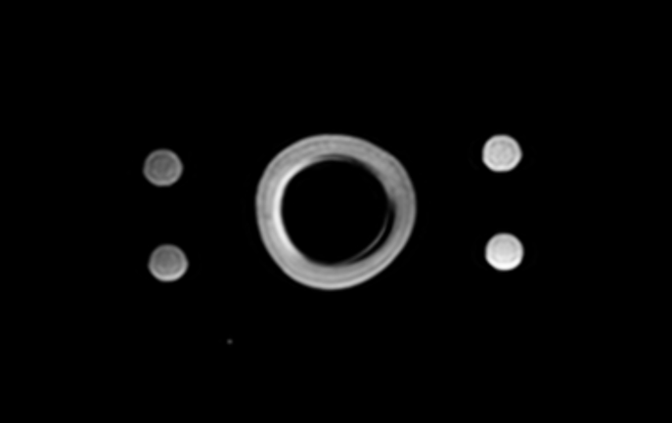
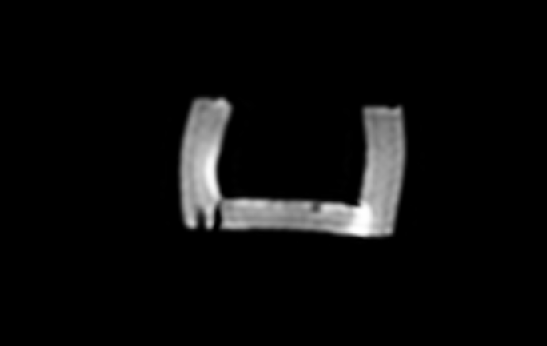

Phantom Data
Cine SSFP
End Diastole
End Systole

Slide 5
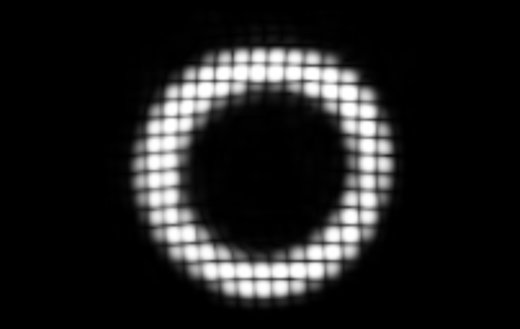


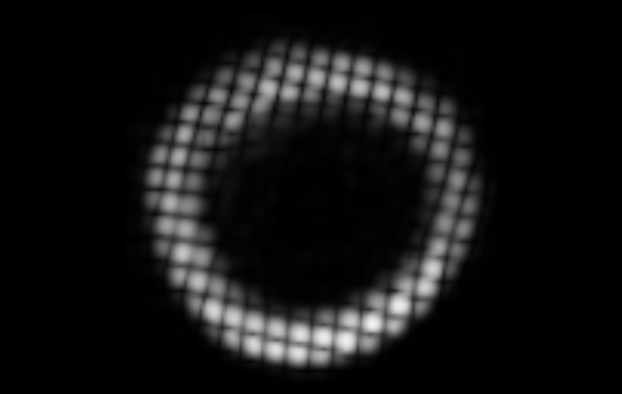


Phantom Data
4D TAG
End Diastole
End Systole

Slide 6
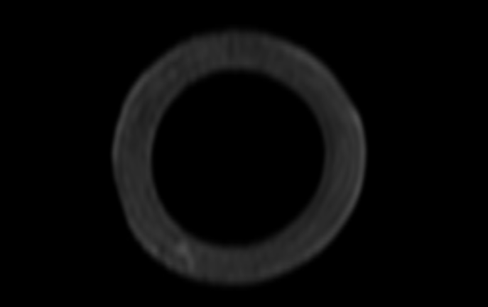
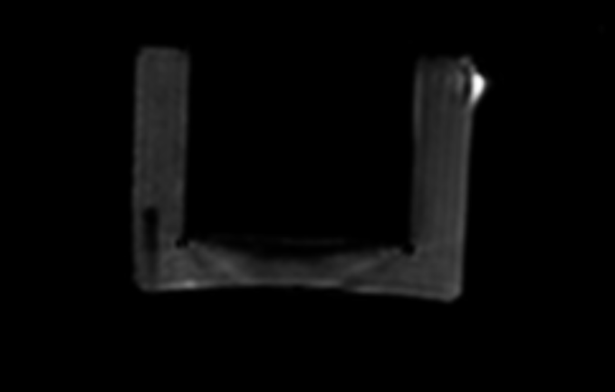

Phantom Data
Whole Heart SSFP
End Diastole

Slide 7
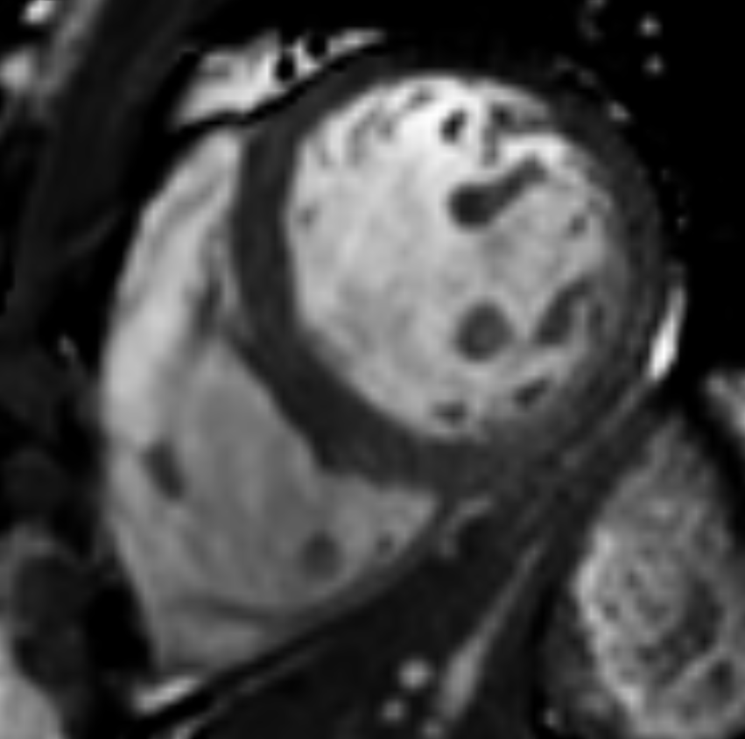
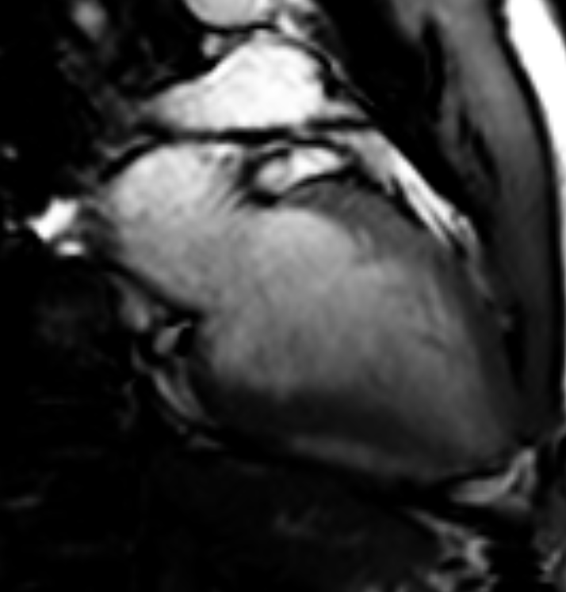
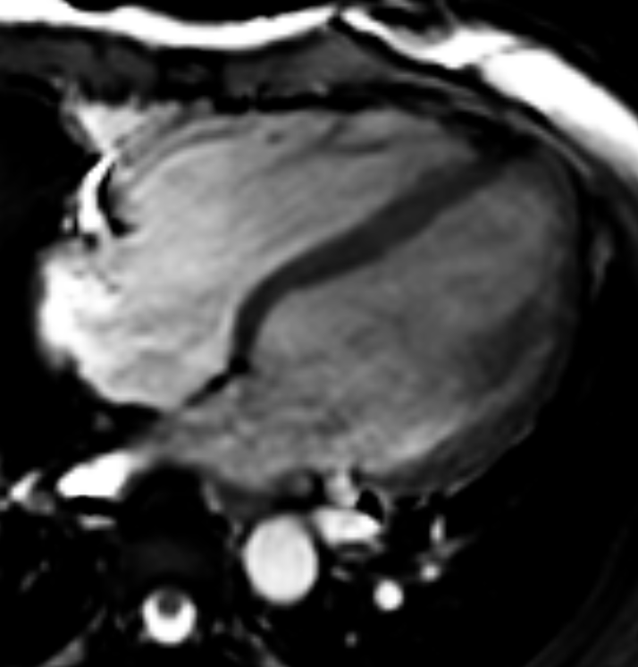
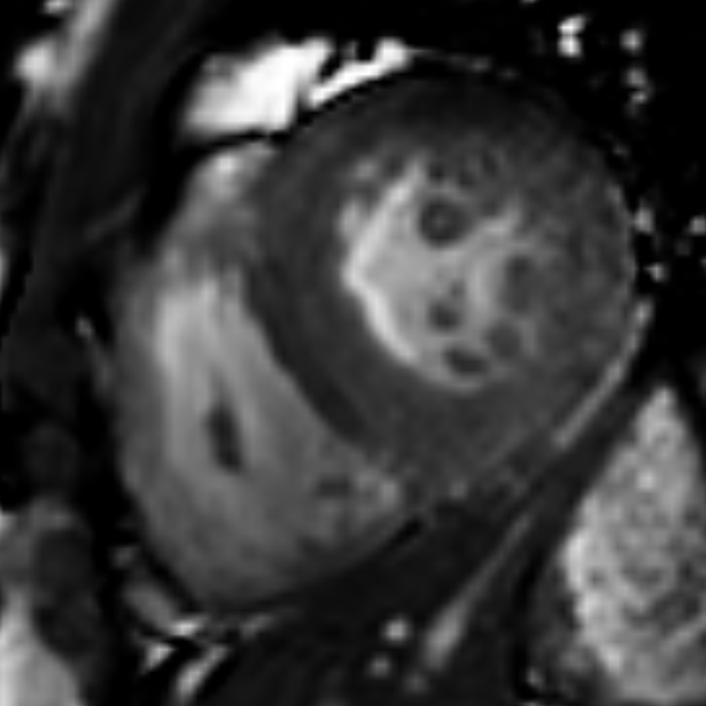
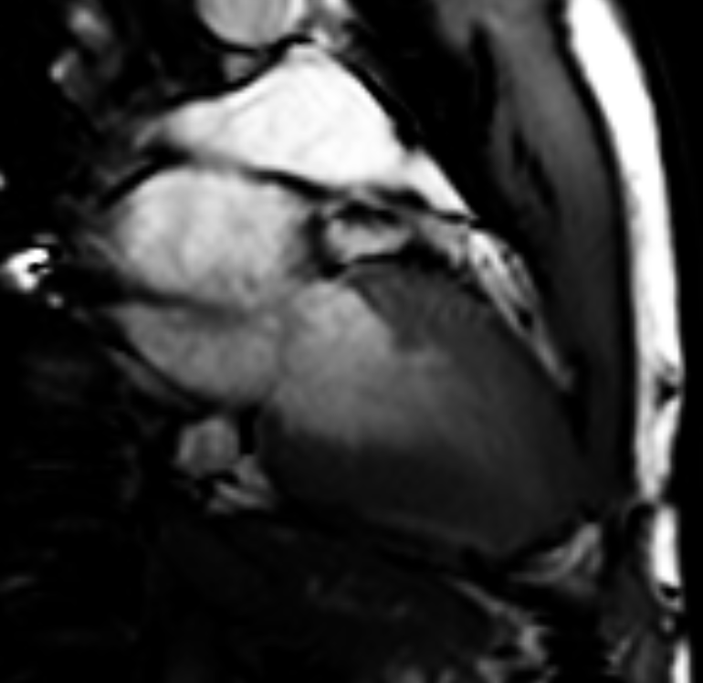
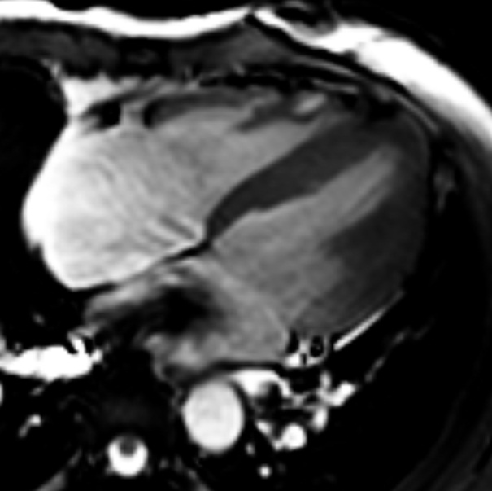
Volunteer Data
Cine SSFP
End Diastole
End Systole

Slide 8
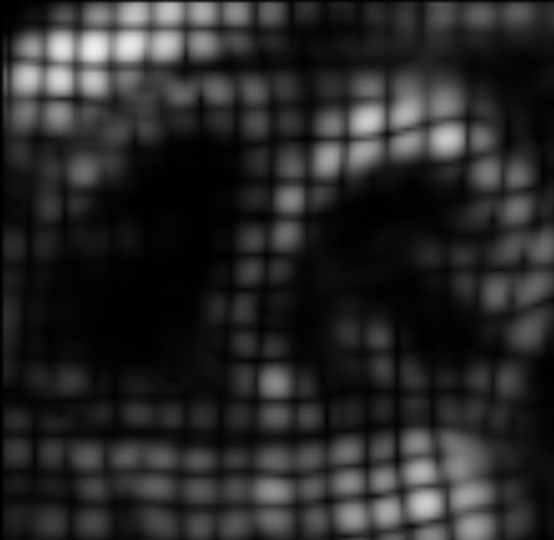




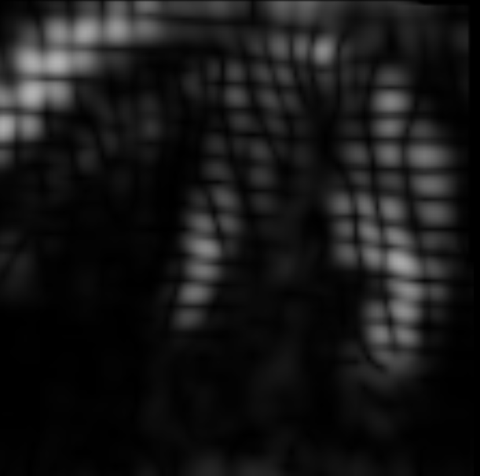
Volunteer Data
4D TAG
End Diastole
End Systole

Slide 9
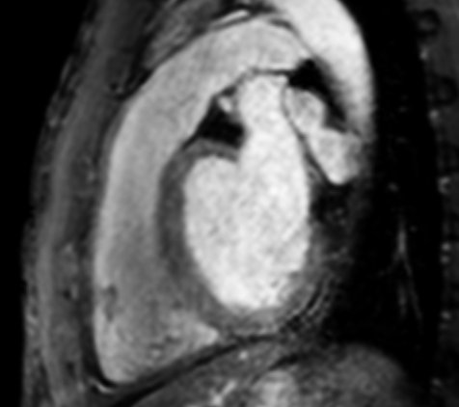
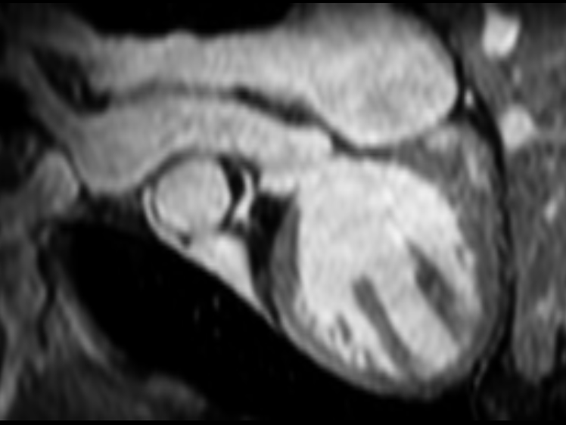
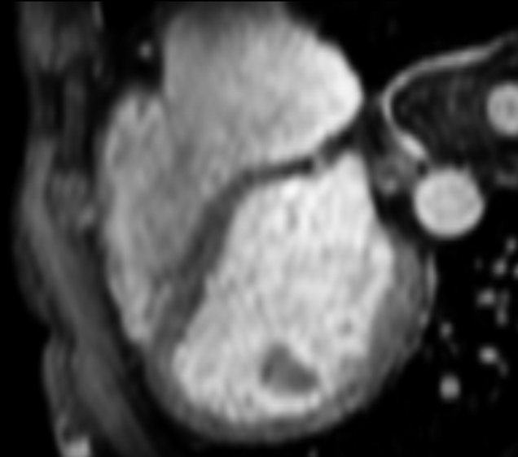
Volunteer Data
Whole Heart SSFP
End Diastole

Slide 10
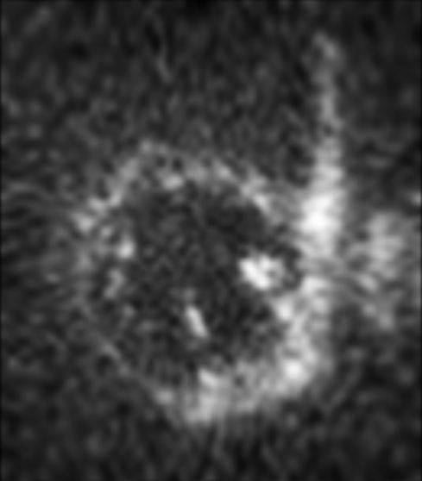
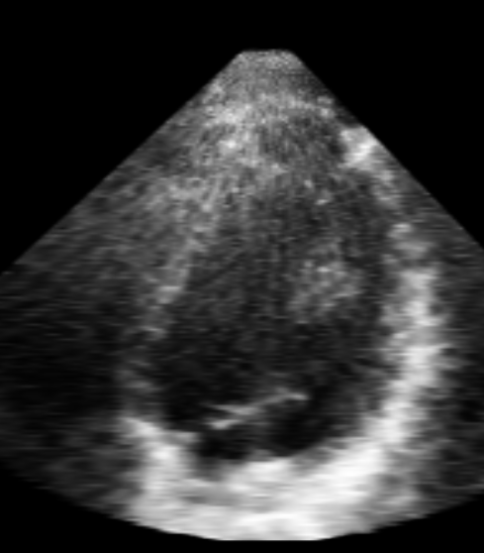
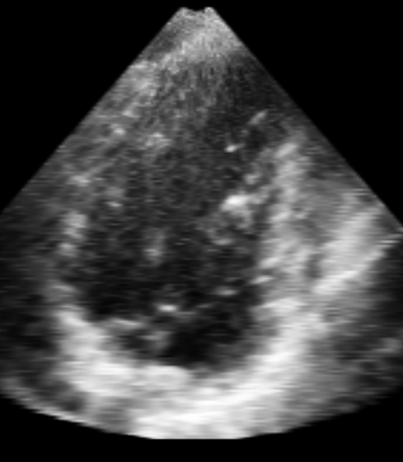
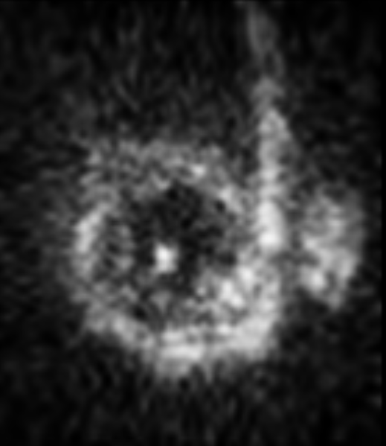
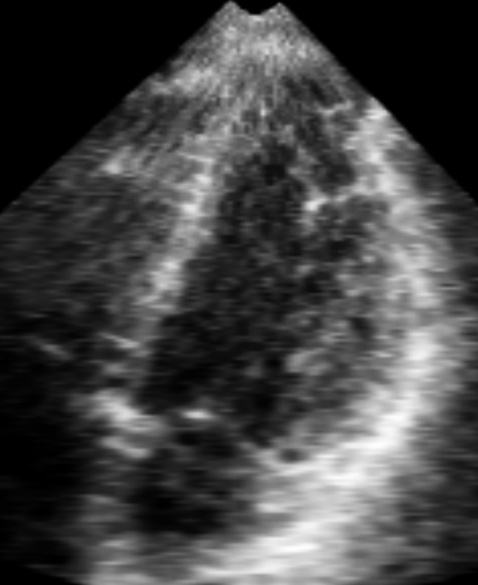
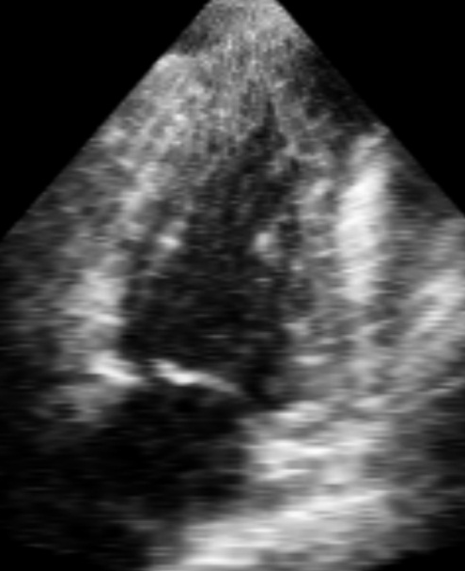
Volunteer Data
3DUS data
End Diastole
End Systole

Slide 11
Summary of Data
 | 3DUS |  | 4ch |  | 2ch |  | sAX |  |  | WH |  | 4DT
 | voxel | ph | voxel | ph | voxel | ph | slices | voxel | ph | slices | voxel | slices | voxel | ph
pha | 1.35x1.16x0.96 | 19 | 1.2x1.2x8 | 30 | 1.2x1.2x8 | 30 | 9 | 1.2x1.2x8 | 30 | 70 | 0.75x0.75x1.6 | 68 | 1.01x1.01x1.01 | 23
V1 | 0.66x0.66x0.58 | 14 | 1.19X1.19X8 | 30 | 1.19X1.19X8 | 30 | 14 | 1.25x1.25x8 | 30 | 95 | 0.75x0.75x1.5 | 111 | 0.96x0.96x0.96 | 23
V2 | 0.66x0.66x0.58 | 16 | 1.13x1.13x8 | 30 | 1.25x1.25x8 | 30 | 11 | 1.25x1.25x8 | 30 | 80 | 0.75x0.75x1.6 | 111 | 0.96x0.96x0.96 | 29
V4 | 0.82x0.83x0.72 | 11 | 1.25x1.25x8 | 30 | 1.25x1.25x8 | 30 | 14 | 1.25x1.25x8 | 30 | 90 | 0.75x0.75x1.5 | 111 | 0.96x0.96x0.96 | 26
V5 | 0.77x0.78x0.68 | 15 | 1.25x1.25x8 | 30 | 1.25x1.25x8 | 30 | 14 | 1.25x1.25x8 | 30 | 94 | 0.75x0.75x1.6 | 111 | 0.96x0.96x0.96 | 23
V6 | 0.82x0.83x0.72 | 14 | 1.13x1.13x8 | 30 | 1.25x1.25x8 | 30 | 14 | 1.25x1.25x8 | 30 | 94 | 0.75x0.75x1.6 | 111 | 0.96x0.96x0.96 | 23
V7 | 0.82x0.83x0.72 | 17 | 1.13x1.13x8 | 30 | 1.15x1.15x8 | 30 | 14 | 1.15x1.15x8 | 30 | 100 | 0.75x0.75x1.6 | 111 | 0.96x0.96x0.96 | 31
V8 | 0.82x0.83x0.72 | 14 | 1.13x1.13x8 | 30 | 1.15x1.15x8 | 30 | 16 | 1.15x1.15x8 | 30 | 100 | 0.75x0.75x1.6 | 111 | 0.96x0.96x0.96 | 31
V9 | 0.82x0.83x0.72 | 14 | 1.13x1.13x8 | 30 | 1.25x1.25x8 | 30 | 14 | 1.25x1.25x8 | 30 | 94 | 0.75x0.75x1.6 | 111 | 0.96x0.96x0.96 | 30
V10 | 0.82x0.83x0.72 | 13 | 1.13x1.13x8 | 30 | 1.25x1.25x8 | 30 | 14 | 1.25x1.25x8 | 30 | 80 | 0.75x0.75x1.6 | 111 | 0.96x0.96x0.96 | 27
V11 | 0.82x0.83x0.72 | 15 | 1.13x1.13x8 | 30 | 1.25x1.25x8 | 30 | 14 | 1.15x1.15x8 | 30 | 100 | 0.75x0.75x1.6 | 111 | 0.96x0.96x0.96 | 32
V12 | 0.82x0.83x0.72 | 13 | 1.13x1.13x8 | 30 | 1.25x1.25x8 | 30 | 14 | 1.25x1.25x8 | 30 | 80 | 0.75x0.75x1.6 | 111 | 0.96x0.96x0.96 | 24
V13 | 0.77x0.77x0.58 | 24 | 1.13x1.13x8 | 30 | 1.25x1.25x8 | 30 | 14 | 1.15x1.15x8 | 30 | 90 | 0.75x0.75x1.5 | 111 | 0.96x0.96x0.96 | 38
V14 | 0.96x0.96x0.72 | 18 | 1.13x1.13x8 | 30 | 1.25x1.25x8 | 30 | 14 | 1.15x1.15x8 | 30 | 75 | 0.75x0.75x1.6 | 111 | 0.96x0.96x0.96 | 29
V15 | 0.96x0.96x0.72 | 13 | 1.13x1.13x8 | 30 | 1.16x1.16x8 | 30 | 12 | 1.25x1.25x8 | 30 | 90 | 0.75x0.75x1.6 | 111 | 0.96x0.96x0.96 | 21
V16 | 0.82x0.83x0.72 | 13 | 1.13x1.13x8 | 30 | 1.16x1.16x8 | 30 | 14 | 1.25x1.25x8 | 30 | 90 | 0.75x0.75x1.6 | 111 | 0.96x0.96x0.96 | 25

Slide 12
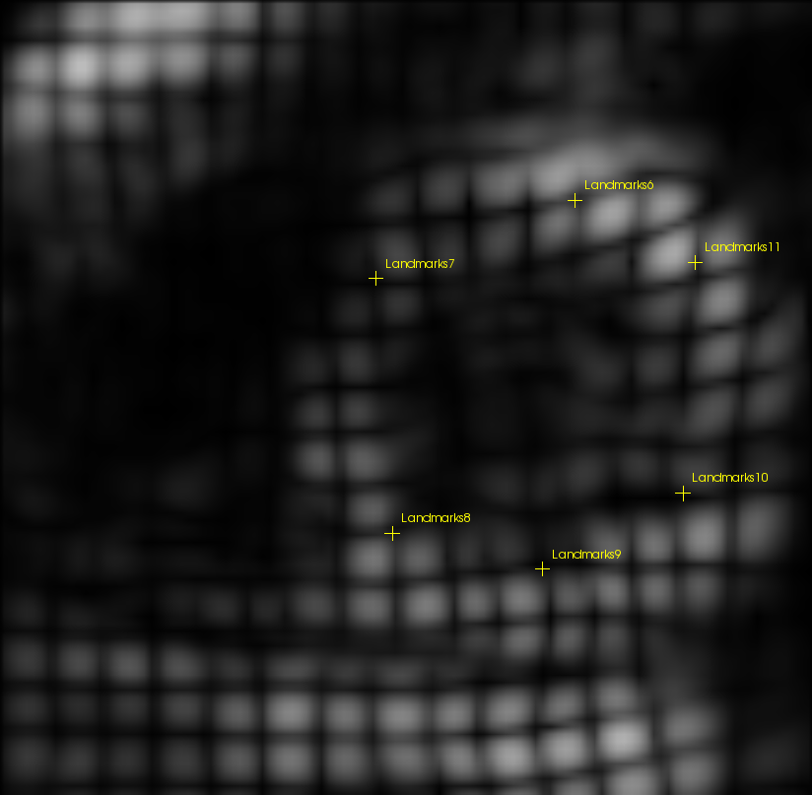
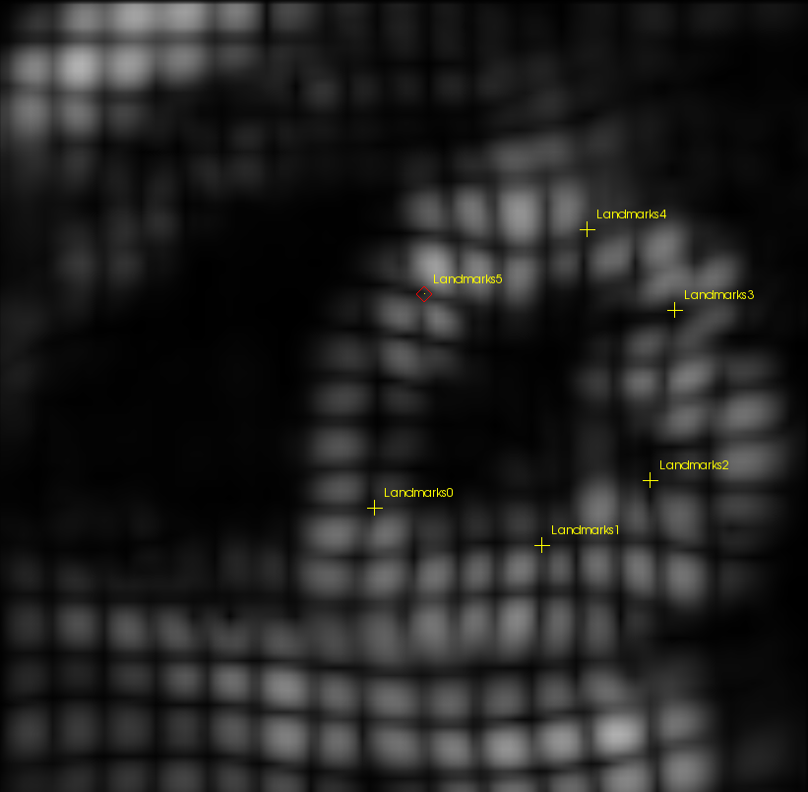
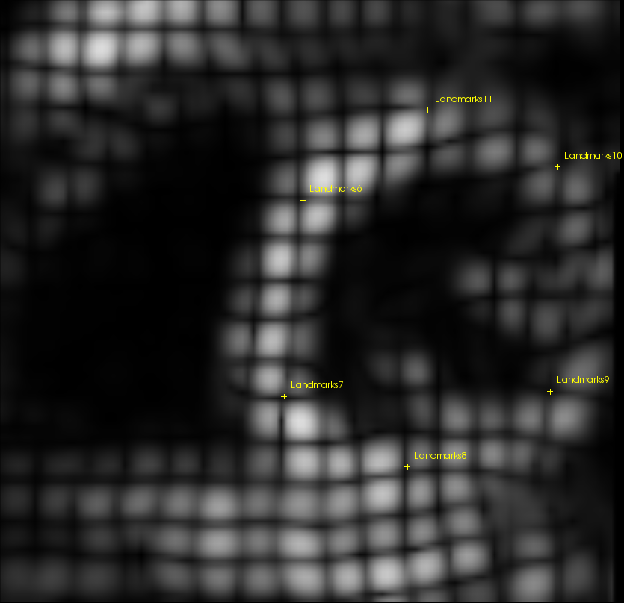
Ground truth
Manual tracking of TAGs → 1 lmk per AHA segment in each phase
4D visualization soft (GIMIAS)
3 observers
End Diastole
End Systole
End Diastole
…
…

